Slide 1



Learning from
spectropolarimetric observations
^{A. Asensio Ramos}
Instituto de Astrofísica de Canarias
aasensio.github.io/blog
@aasensior
github.com/aasensio

Slide 2
Learning from observations is an ill-posed problem

Slide 3
Follow these four steps
Understand your problem
Understand the model that ‘generates’ your data
Define a merit function
Compute the ‘best’ fit by optimizing or sample
this merit function
The solution to any model fitting
has to be probabilistic

Slide 4
Understand your problem
Your data has been obtained with an instrument
Your synthetic model might not explain what you see
You are surely not understanding your errors
Systematics
…

Slide 5


Understand your generative model
This is the most important and complex part of the inference
Example
Generative model
Assumptions
We assume that x_{i} are fixed and given with zero uncertainty
Uncertainty in the measurement is Gaussian with zero mean
and diagonal covariance

Slide 7

From the generative model to the merit function
Likelihood
Probability that the measured data has been
generated from the model

Slide 8

Why do we do the χ² fitting?
The standard least-squares fitting comes from the
maximization of a Gaussian likelihood

Slide 9
Some subtleties
Weights
  Do not change the position of the maximum
  Modify the curvature at the maximum
If noise statistics change, modify the likelihood

Slide 11
Be aware of the assumptions
Errors are Gaussian
You know the errors → it is difficult to estimate uncertainties
in the errors because errors are already a 2nd order statistics
Errors are only on the y axis → x locations are given
with infinite precision
The model includes the truth

Slide 12
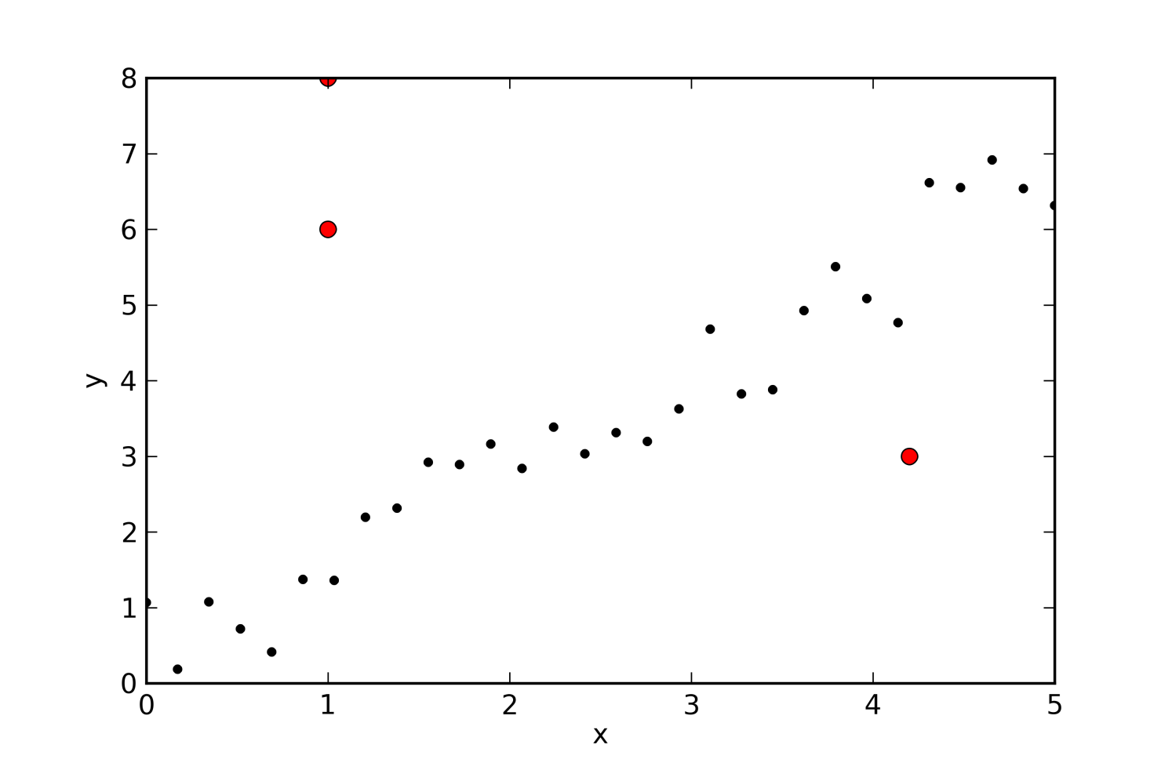
What if we break the assumptions?
Any of our assumptions might be broken
Errors are not Gaussian
We don’t know the errors
Errors are also on the x axis
The model does not include the truth

Slide 13
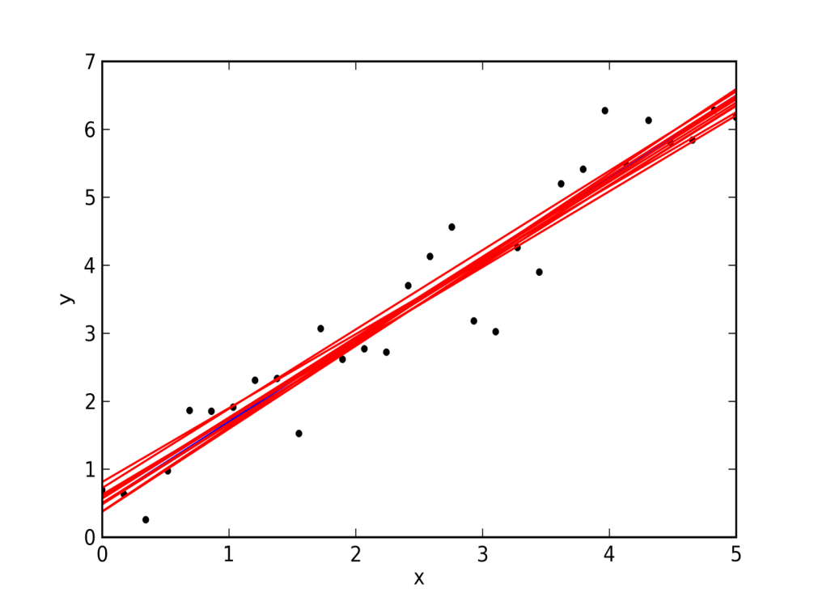
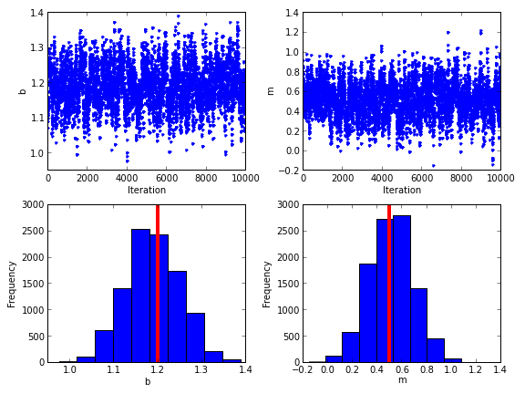
Without outliers

Slide 14
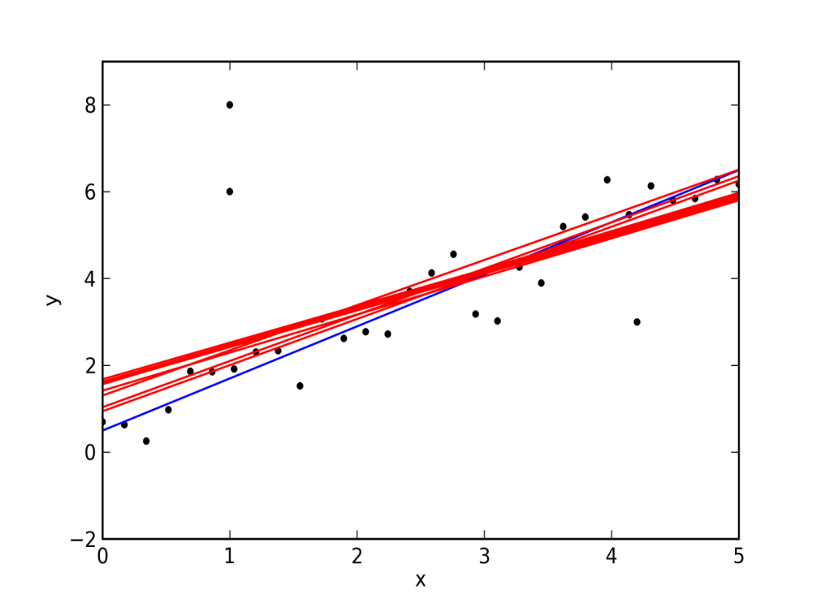
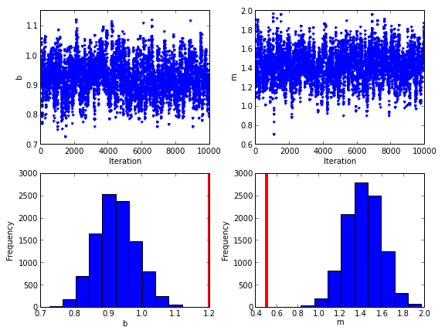
With outliers
We get biased results

Slide 15

Model everything
If you model the data points and the outliers, you automatically
have a generative model and a merit function to optimize
points from the line
bad point

Slide 16
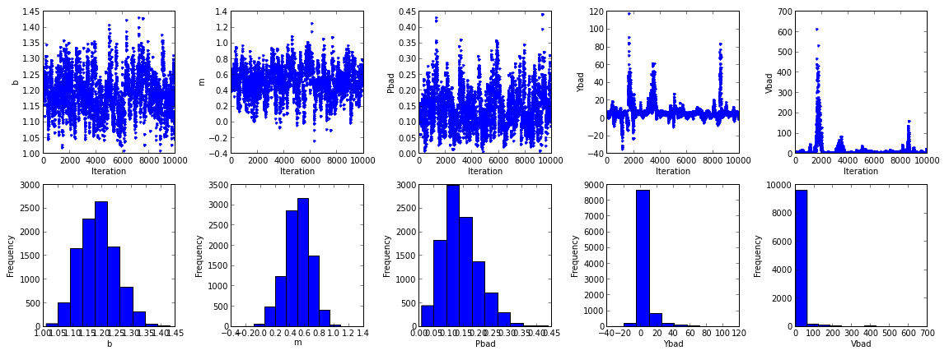
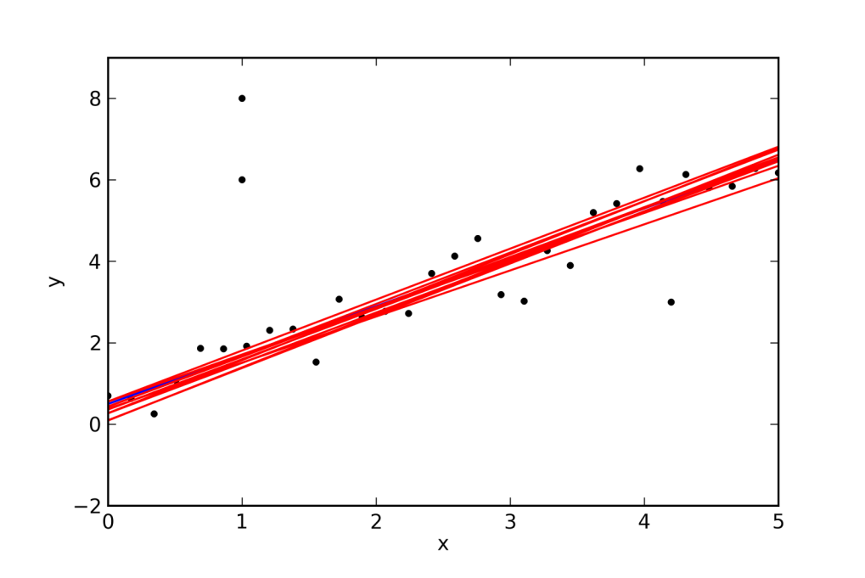

Slide 17
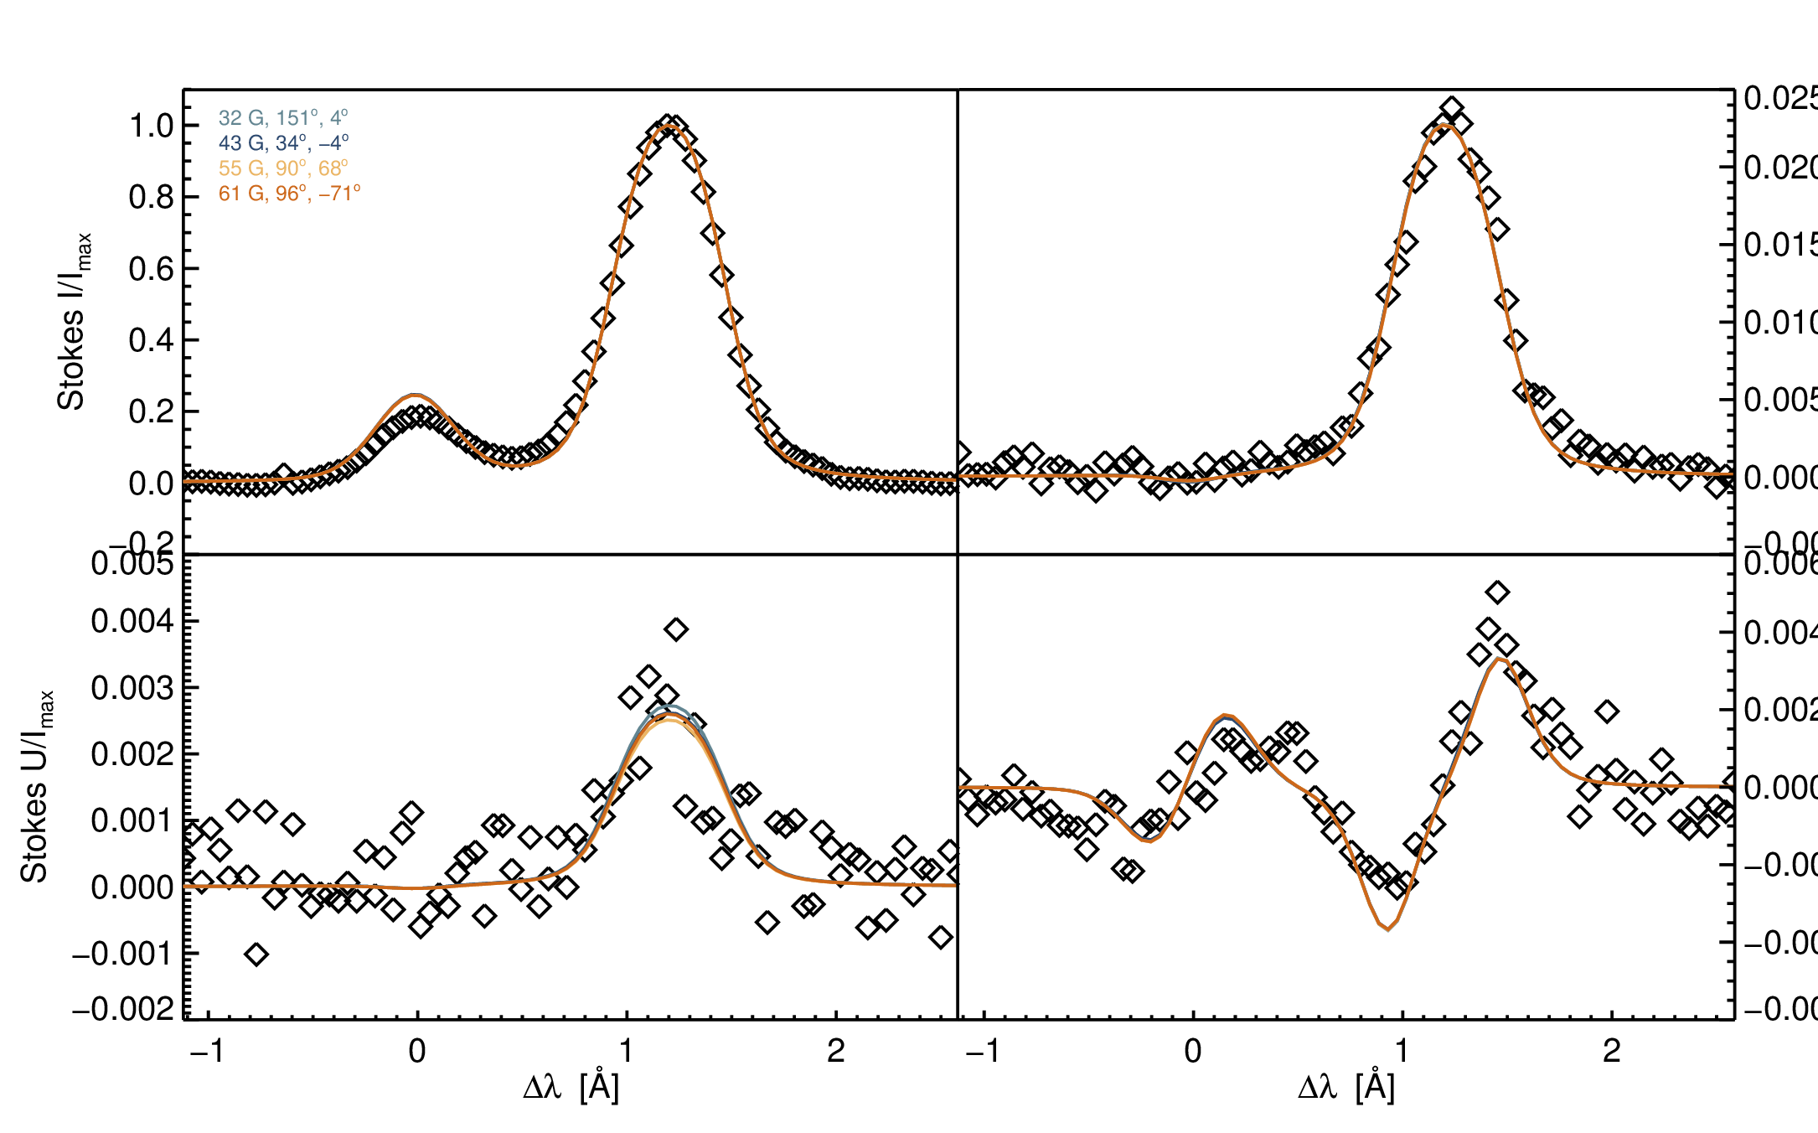
Fitting He I 10830 Å profiles

Slide 18

Hazel
github.com/aasensio/hazel
MIT license

Slide 20
Assumptions + properties
Multi-term atom
Simplified but realistic radiative transfer effects
One or two components (along LOS or inside pixel)
Magneto-optical effects
MIT license
MPI using master-slave scheme
Scales almost linearly with N-1 (tested with up to 500 CPUs)
Python wrapper for synthesis

Slide 21
3d³D
3p³P
3s³S
2p³P
10830 Å
2s³S

Slide 22
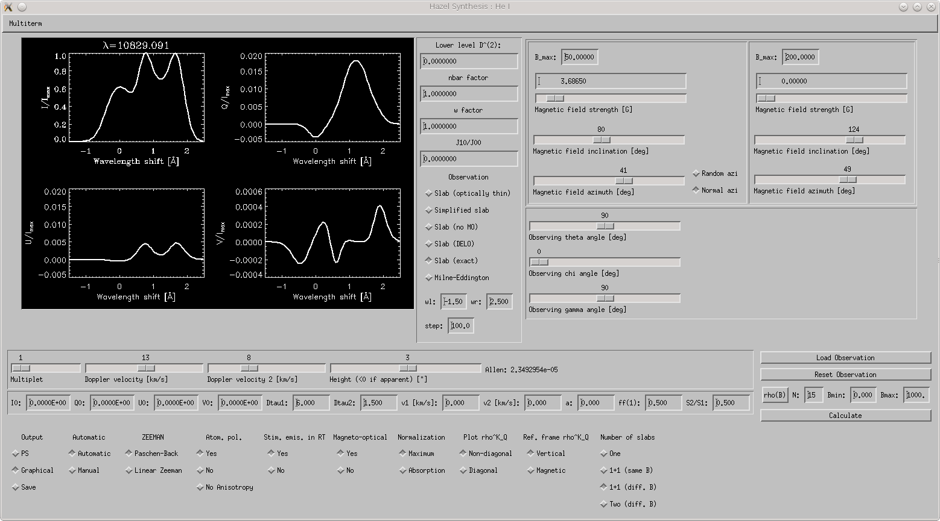
Forward modelling

Slide 23
Problems with inversion
Robustness
Sensitivity to parameters
Ambiguities

Slide 24
Robustness: 2-step inversion
Global convergence → DIRECT
Refinement → Levenberg-Marquardt
Step 1
Step 2
Step 3
DIRECT algorithm (Jones et al 93)

Slide 25
Sensitivity to parameters: cycles
Modify weights and do cycles
Cycle 1
Invert thermodynamical properties
τ, Δv_{th}, v_{Dopp}, …
Stokes I
Cycle 2
Stokes Q, U, V
Invert magnetic field vector

Slide 26
Ambiguities

Slide 27
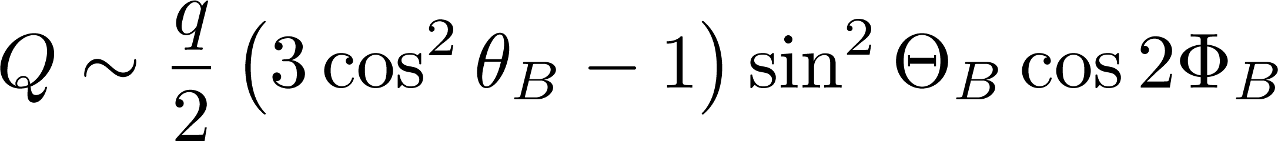
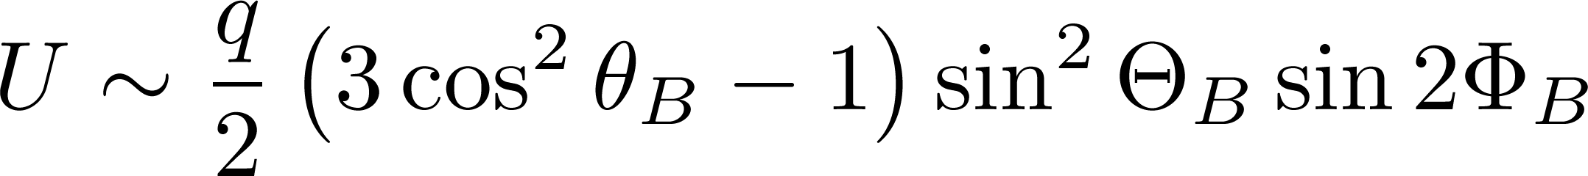
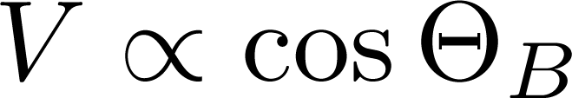
Ambiguities: off-limb approach
Do a first inversion with Hazel
Saturation regime → find the ambiguous solutions (<8)
In the saturation regime (above ~40 G for He I 10830)

Slide 28
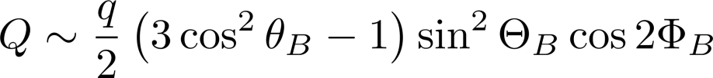
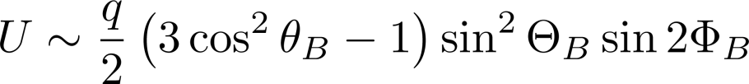

Ambiguities: off-limb approach
Do a first inversion with Hazel
Saturation regime → find the ambiguous solutions (<8)
For each solution, use Hazel to refine the inversion
Now almost automatically with Hazel

Slide 29
Where to go from here?
Do full Bayesian inversion
Model comparison
Inversions with constraints
Model everything, including systematics, and
integrate out nuisance parameters

Slide 30
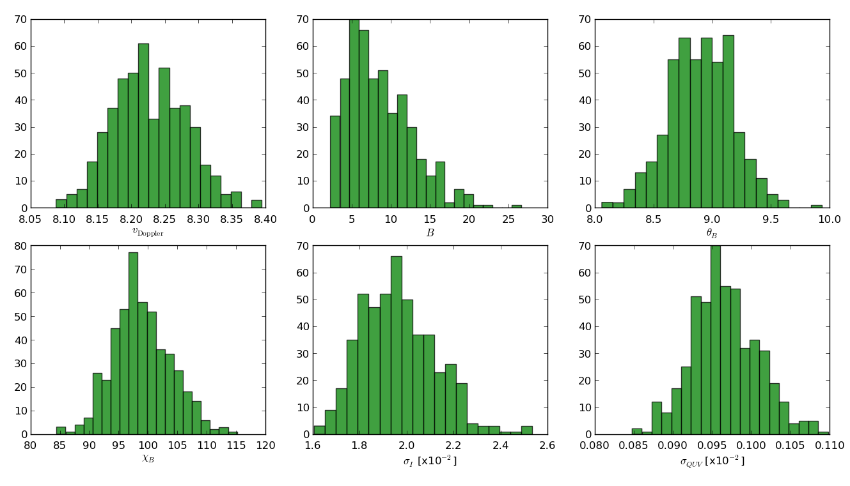
Bayesian inference
PyHazel+PyMultinest

Slide 31
Model comparison
H₀ : simple Gaussian
H₁ : two Gaussians of equal width but unknown amplitude ratio

Slide 32


Model comparison
H₀ : simple Gaussian
H₁ : two Gaussians of equal width but unknown amplitude ratio

Slide 33
Model comparison

Slide 34


Model comparison
ln R=2.22 → weak-moderate evidence
in favor of model 1

Slide 35
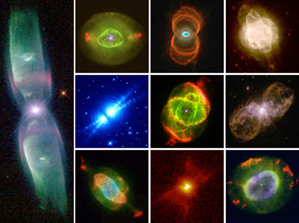
Constraints

Slide 36
Central stars of planetary nebulae

Slide 37
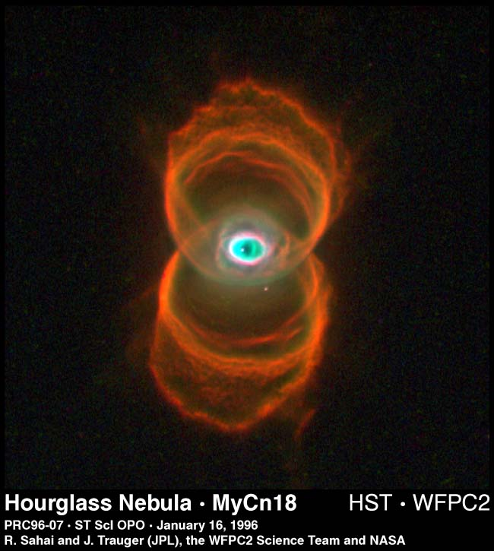
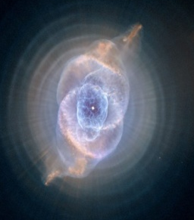
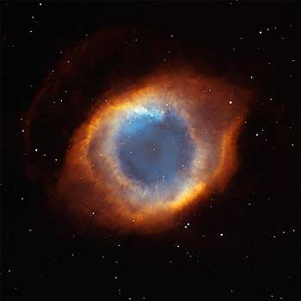
Bayesian hierarchical model
Model
F_{V}
B₁,μ₁
b₀
B₂,μ₂
Model
F_{V}
Model
F_{V}
B₃,μ₃

Slide 38
Bayesian hierarchical model

Slide 39
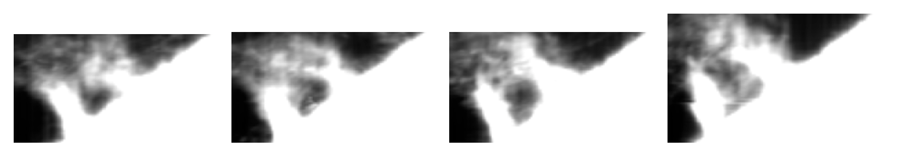
Are solar tornadoes and barbs the same?
Core of the He I line at 1083.0 nm (~0.8’’)
Full Stokes He I line at 1083.0 nm (VTT+TIP II)
Imaging at the core of the Hα line (VTT - diffraction limited MOMFBD)
Imaging at the core of the Ca II K (VTT - diffraction limited MOMFBD)
Imaging from SDO

Slide 40
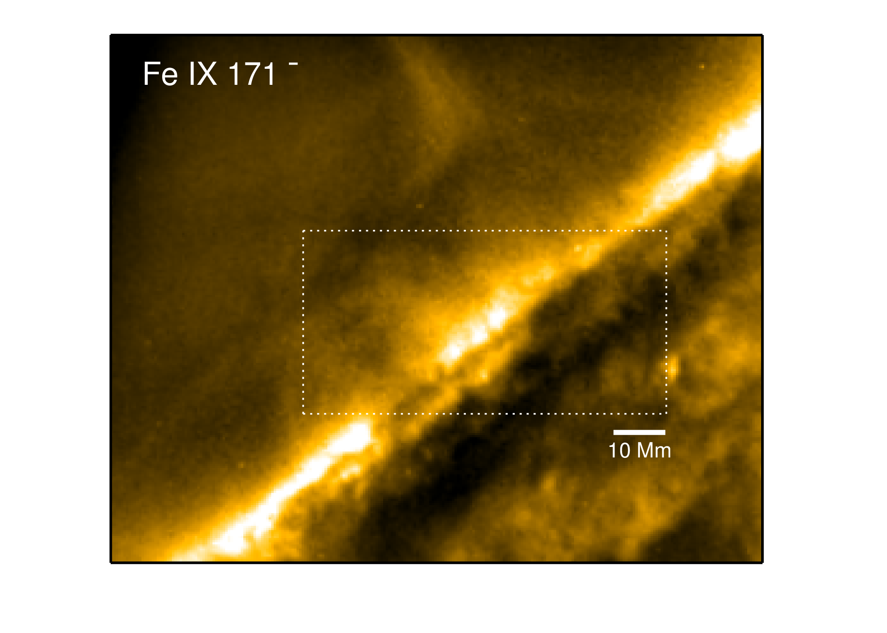
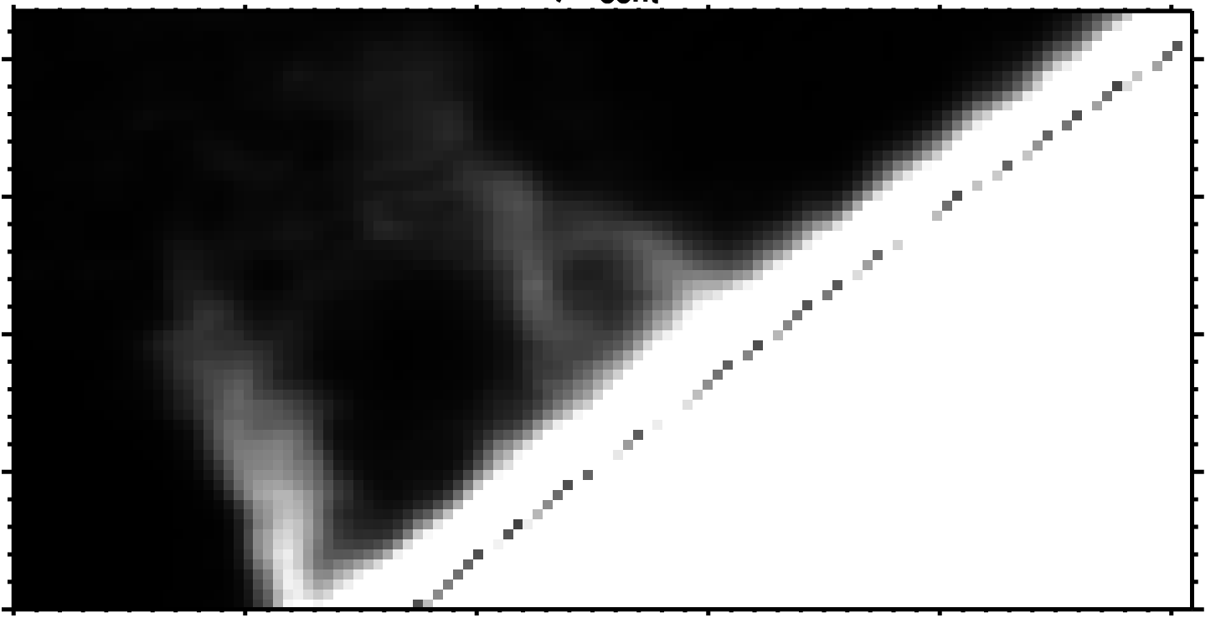
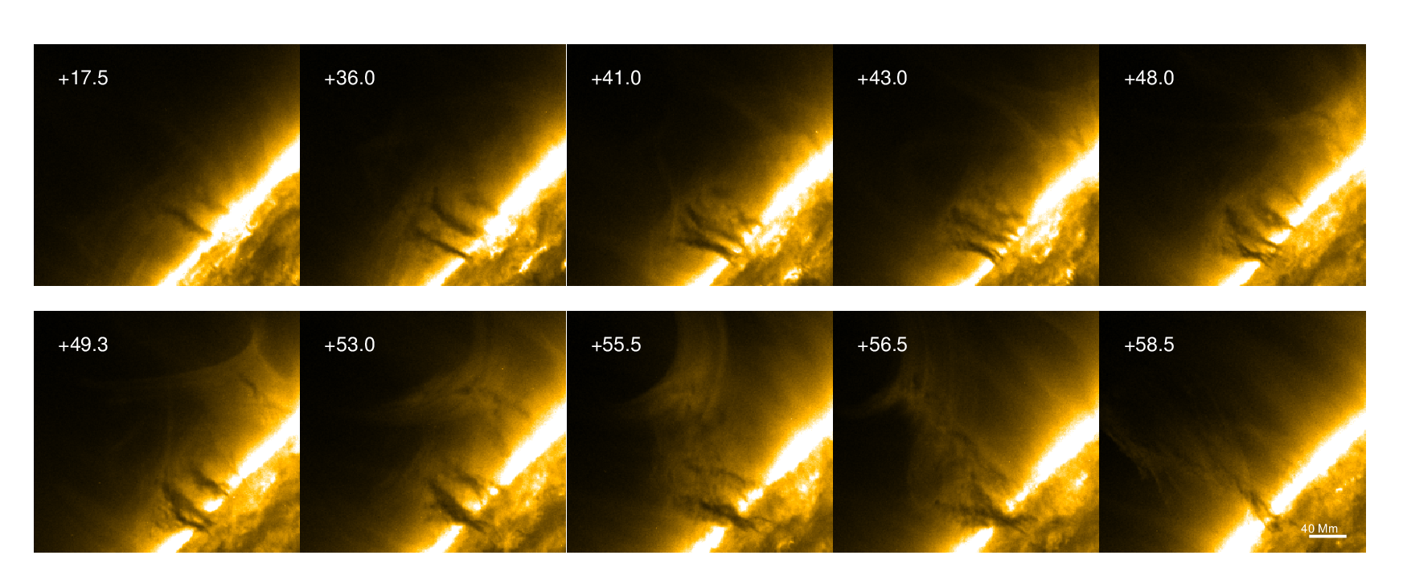
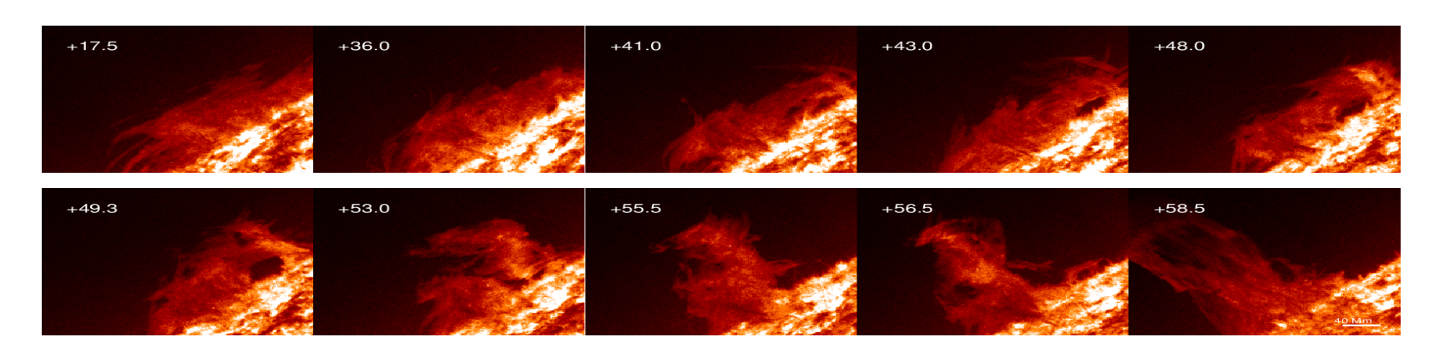
Coincidence with tornadoes in AIA

Slide 41
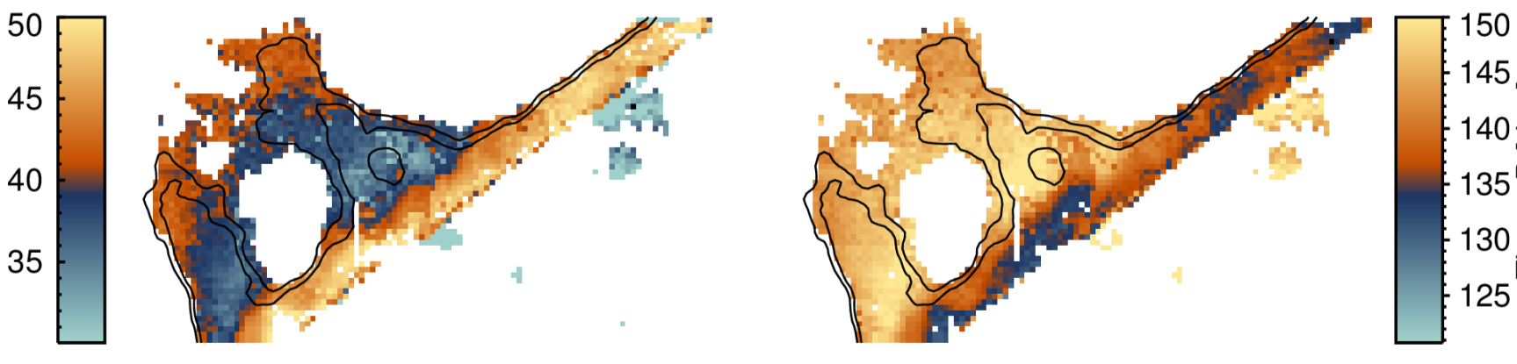
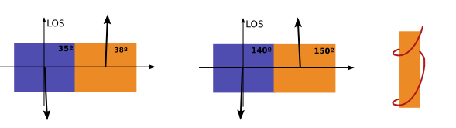

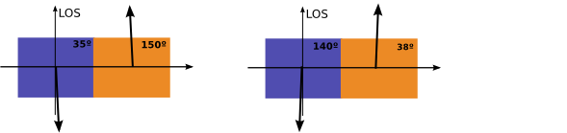
``Vertical’’ solutions
Field inclination

Slide 42
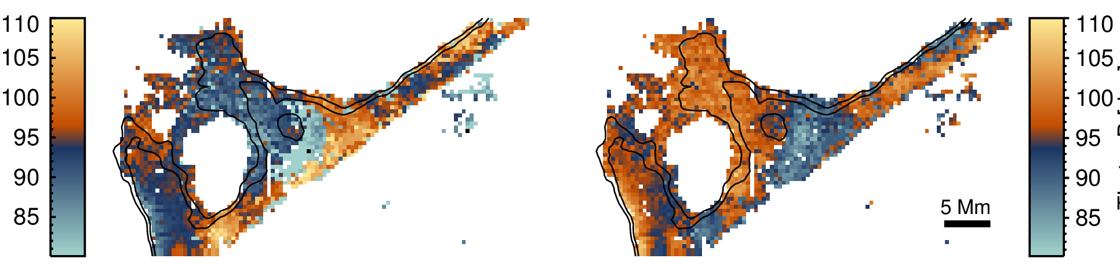
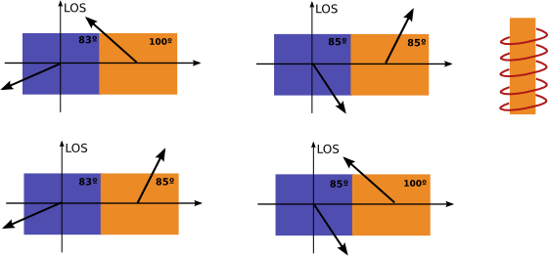
``Horizontal’’ solutions
Field inclination

Slide 43
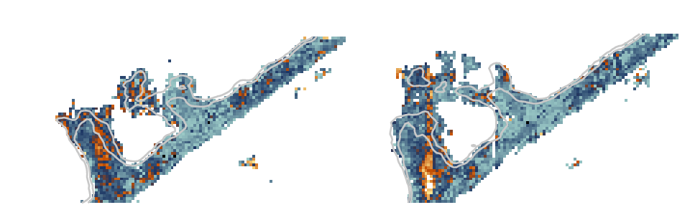
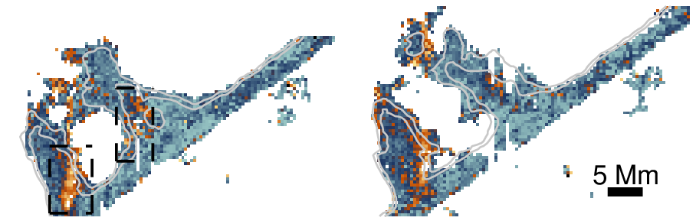
Magnetic field is robust
Fields are statistically below 20 G
Some regions reach 50-60 G
Filamentary vertical structures in magnetic field strength

Slide 44
Conclusions
Be aware of your assumptions
Model everything if possible
Hazel is freely available
Ambiguities can be problematic
More work to put chromospheric inversions
at the level of photospheric inversions

Slide 45

Announcement
IAC Winter School on Bayesian Astrophysics
La Laguna, November 3-14, 2014

Slide 46
Inversion procedure
Radiation field
Radiation field anisotropy
B, , v_{th}, v_{mac}, a
Solve SEE
equations
Solve RT equation
Emergent profiles
Observed
Stokes profiles
Statistical estimator (²)
NO
² smaller than
previous?
NO
Convergence?
Propose another
set of parameters
YES
YES
Save parameters
EXIT

